Slide 1




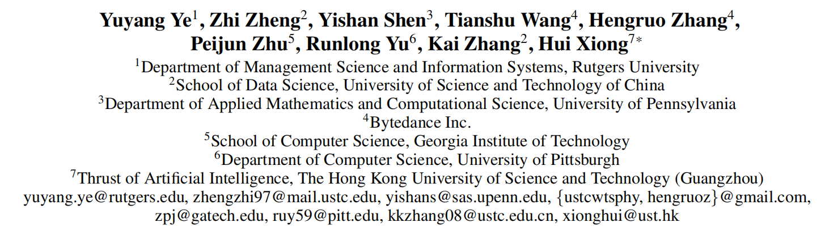





ATAI
Advanced Technique of Artificial Intelligence
ATAI
ChongqingUniversity _{AdvancedTechniqueof}
of Technology Artificial Intelligence
Chongqing University of
Technology
Chongqing University ^{ATAI}
_{of Technology} Advanced Techniqueof
Artificial Intelligence
Chongqing University of Technology
Chongqing University of Technology
Harnessing Multimodal Large Language Models for Multimodal Sequential Recommendation
Code: https://github.com/YuyangYe/MLLM-MSR
—AAAI_2025
Reported by Cong Sheng
1

Slide 2
ATAI
Advanced Technique of Artificial Intelligence
ATAI
ChongqingUniversity _{AdvancedTechniqueof}
of Technology Artificial Intelligence
Chongqing University of
Technology
Chongqing University ^{ATAI}
_{of Technology} Advanced Techniqueof
Artificial Intelligence
Chongqing University of Technology
Chongqing University of Technology
Motivation
Current key challenges:
1)Difficulties in processing sequential multimodal data: MLLMs struggle to effectively process and comprehend multimodal items within sequential user behavior histories.
2)Capturing dynamic user preferences: Traditional MLLMs are inadequate at capturing the temporal evolution of user interests through sequential interactions.
3)Overfitting and generalization: When fine-tuned for specific recommendation scenarios, MLLMs are prone to overfitting and risk losing their valuable general knowledge.

Slide 3
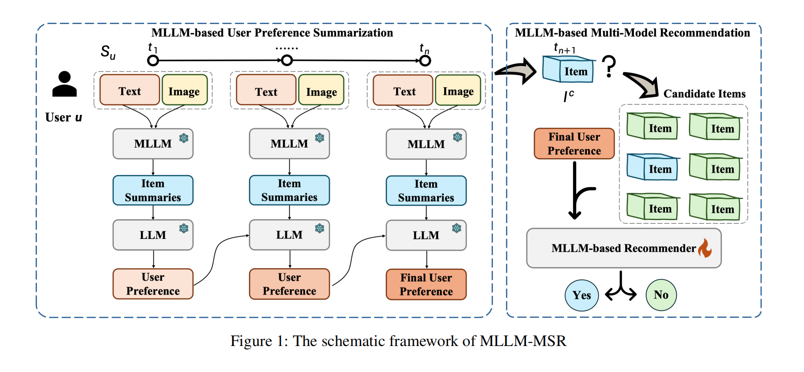
ATAI
Advanced Technique of Artificial Intelligence
ATAI
ChongqingUniversity _{AdvancedTechniqueof}
of Technology Artificial Intelligence
Chongqing University of
Technology
Chongqing University ^{ATAI}
_{of Technology} Advanced Techniqueof
Artificial Intelligence
Chongqing University of Technology
Chongqing University of Technology
Overview

Slide 4
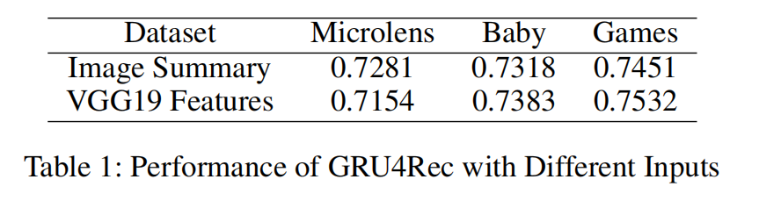
ATAI
Advanced Technique of Artificial Intelligence
ATAI
ChongqingUniversity _{AdvancedTechniqueof}
of Technology Artificial Intelligence
Chongqing University of
Technology
Chongqing University ^{ATAI}
_{of Technology} Advanced Techniqueof
Artificial Intelligence
Chongqing University of Technology
Chongqing University of Technology
Method

Slide 5
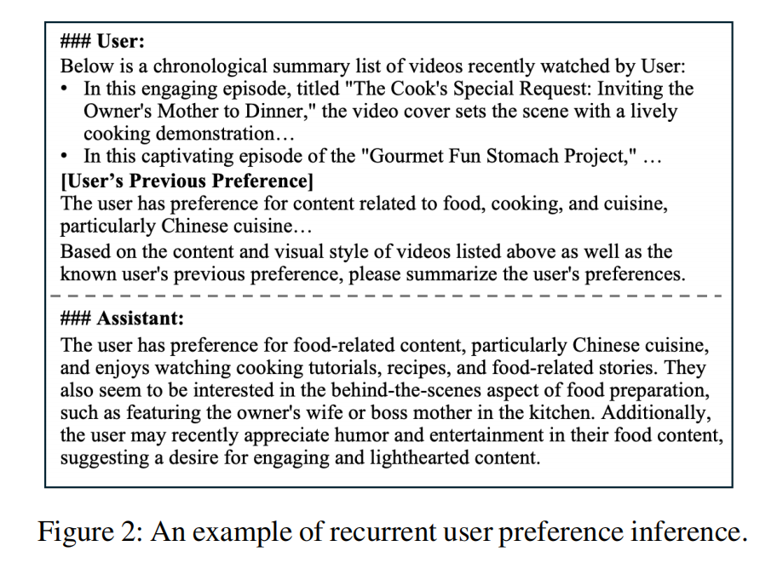
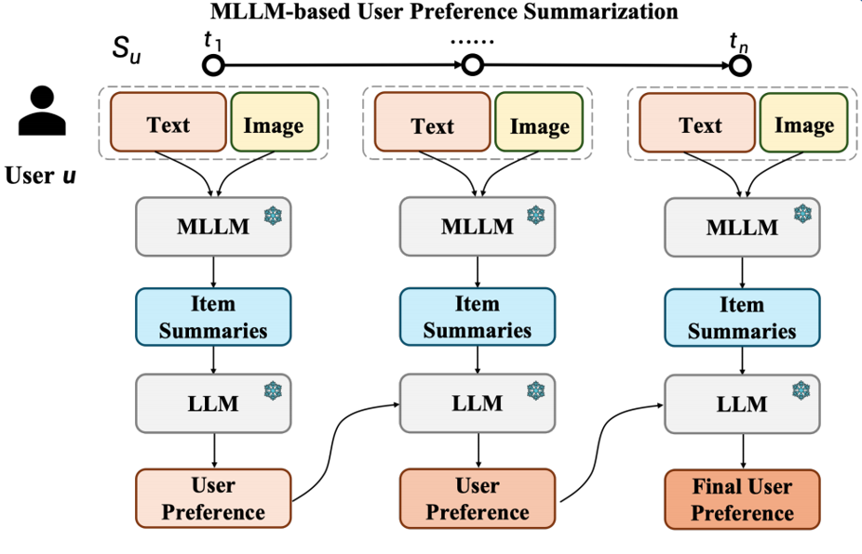
ATAI
Advanced Technique of Artificial Intelligence
ATAI
ChongqingUniversity _{AdvancedTechniqueof}
of Technology Artificial Intelligence
Chongqing University of
Technology
Chongqing University ^{ATAI}
_{of Technology} Advanced Techniqueof
Artificial Intelligence
Chongqing University of Technology
Chongqing University of Technology
Method

Slide 6
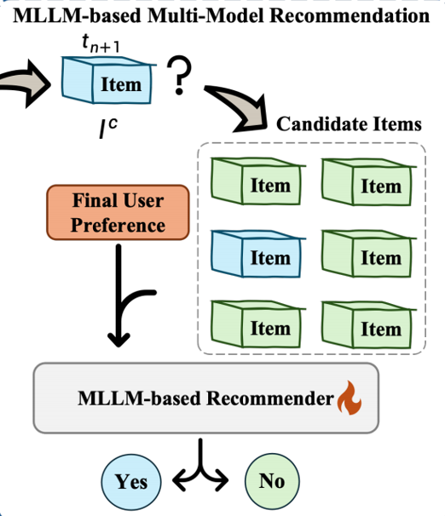
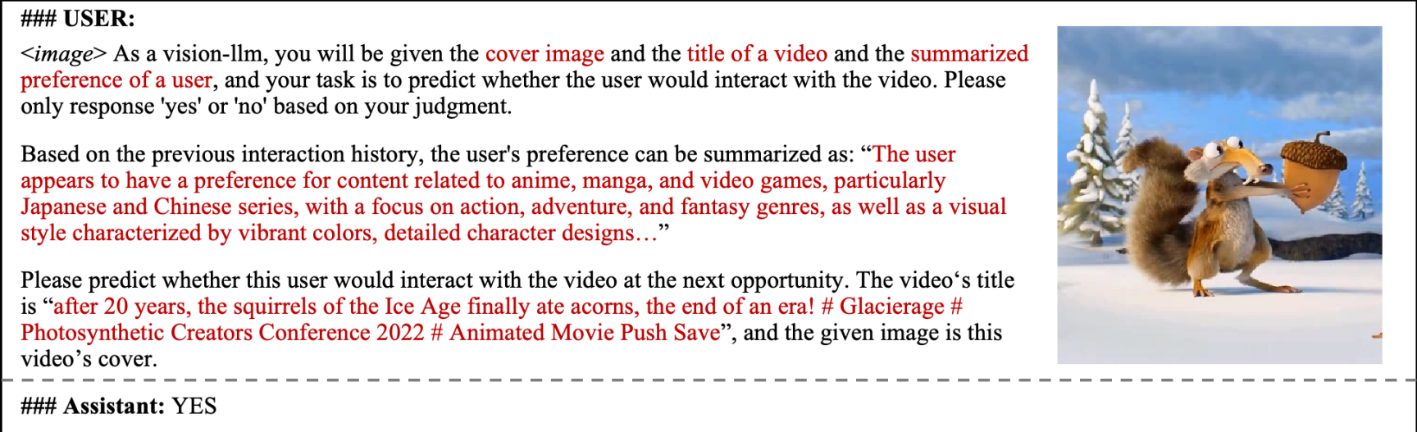
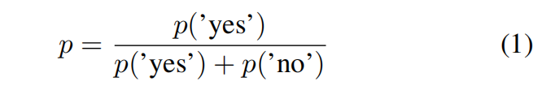
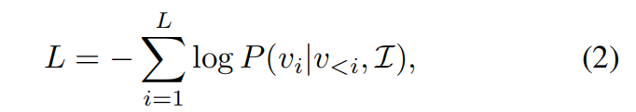
ATAI
Advanced Technique of Artificial Intelligence
ATAI
ChongqingUniversity _{AdvancedTechniqueof}
of Technology Artificial Intelligence
Chongqing University of
Technology
Chongqing University ^{ATAI}
_{of Technology} Advanced Techniqueof
Artificial Intelligence
Chongqing University of Technology
Chongqing University of Technology
Method

Slide 7
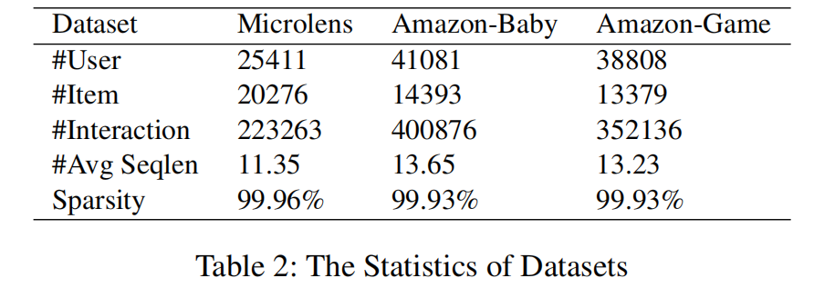
ATAI
Advanced Technique of Artificial Intelligence
ATAI
ChongqingUniversity _{AdvancedTechniqueof}
of Technology Artificial Intelligence
Chongqing University of
Technology
Chongqing University ^{ATAI}
_{of Technology} Advanced Techniqueof
Artificial Intelligence
Chongqing University of Technology
Chongqing University of Technology
Experiments

Slide 8
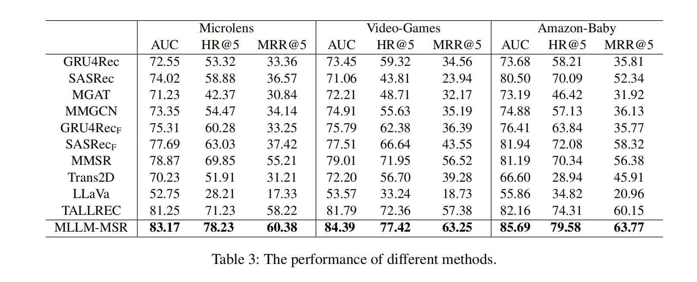
ATAI
Advanced Technique of Artificial Intelligence
ATAI
ChongqingUniversity _{AdvancedTechniqueof}
of Technology Artificial Intelligence
Chongqing University of
Technology
Chongqing University ^{ATAI}
_{of Technology} Advanced Techniqueof
Artificial Intelligence
Chongqing University of Technology
Chongqing University of Technology
Experiments

Slide 9

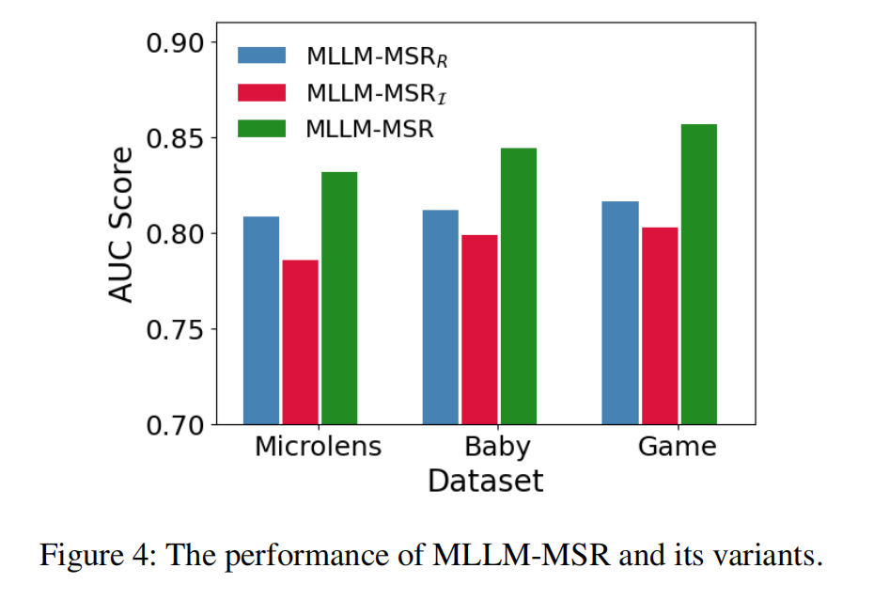
ATAI
Advanced Technique of Artificial Intelligence
ATAI
ChongqingUniversity _{AdvancedTechniqueof}
of Technology Artificial Intelligence
Chongqing University of
Technology
Chongqing University ^{ATAI}
_{of Technology} Advanced Techniqueof
Artificial Intelligence
Chongqing University of Technology
Chongqing University of Technology

Slide 10
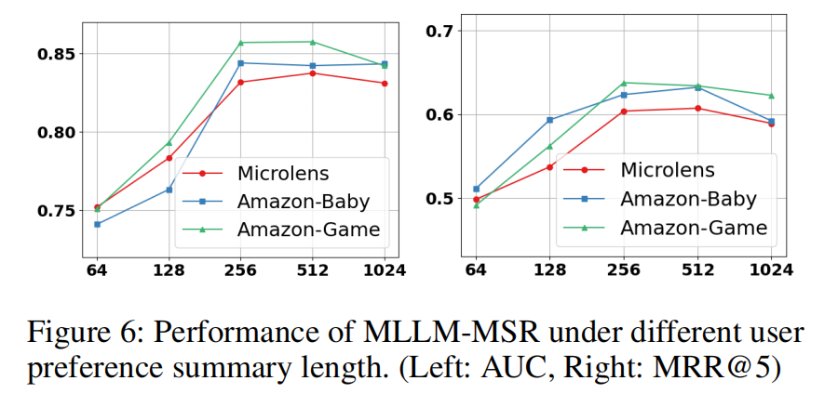
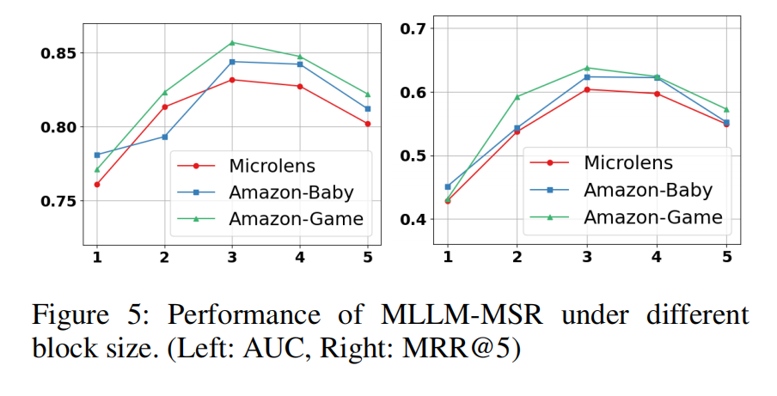
ATAI
Advanced Technique of Artificial Intelligence
ATAI
ChongqingUniversity _{AdvancedTechniqueof}
of Technology Artificial Intelligence
Chongqing University of
Technology
Chongqing University ^{ATAI}
_{of Technology} Advanced Techniqueof
Artificial Intelligence
Chongqing University of Technology
Chongqing University of Technology

